Slide 1
Why do we study history?
8th Grade Social Studies
Sept. 1, 2015

Slide 2
What is history?
History is the study of people, places, and events in time.
What time periods of history do you like and why?

Slide 3
How is history passed?
Oral Language
Earliest form of expression
Stories passed by word of mouth
What’s the Problem?
Telephone Game
Stories Change as retold
Details Lost or Added
Written Language
Signifier for a civilization
Pictographs
Symbols or characters that represent words or phases
Cave Paintings
Alphabets
What’s the Problem?
Things get lost or damaged
Point of View / Perspective
Interpretation

Slide 4
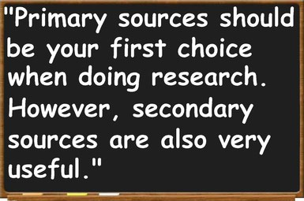
Primary vs. Secondary history sources
Sources:
Primary: 1st hand accounts or artifacts
Secondary: based on research of primary sources or other secondary sources
Both contain bias

Slide 5
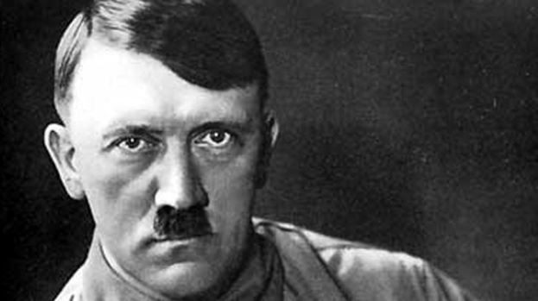
What is your opinion of this man?

Slide 6
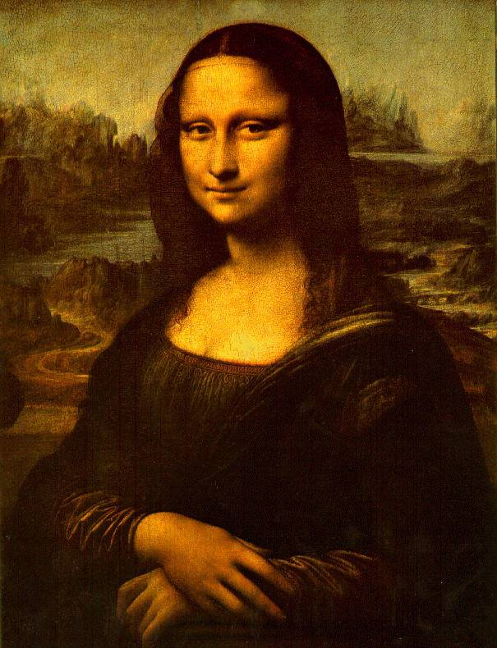
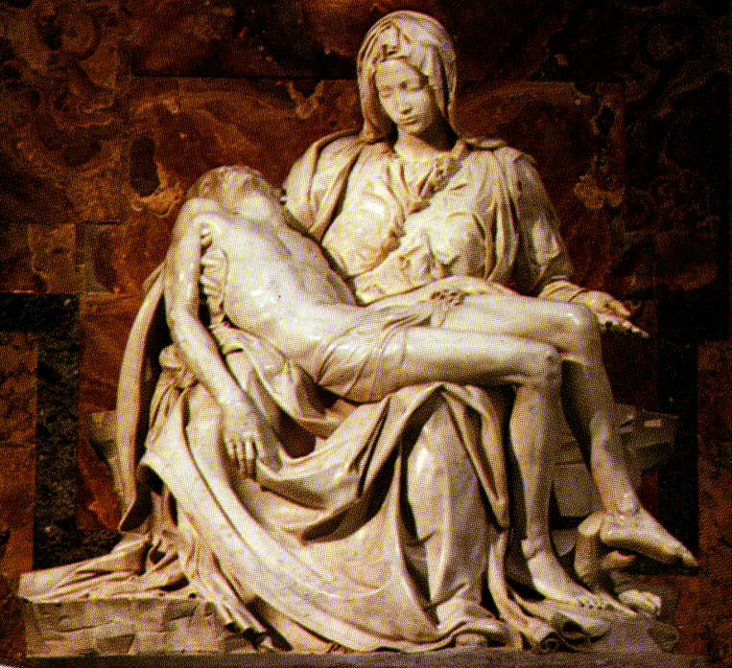
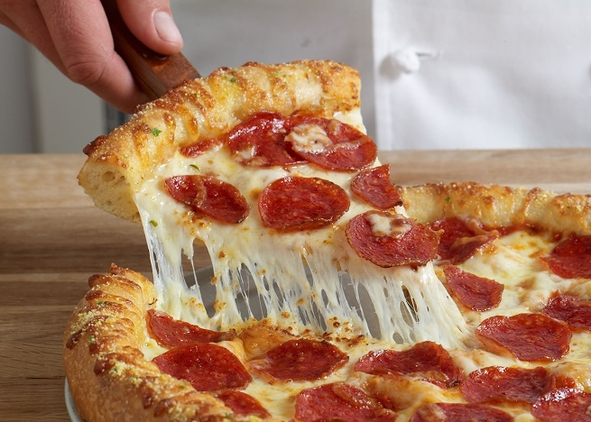
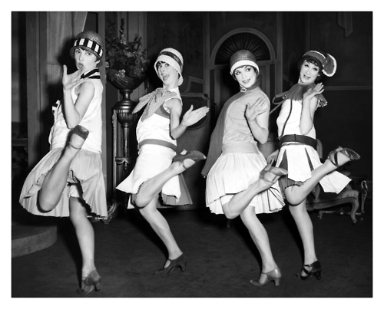
How are these things part of history?

Slide 7
How is this current issue related to history?

Slide 8
Examples of Primary Sources
US Constitution
Abraham Lincoln Quotes
Journals of Lewis and Clark
Recorded video and audio tapes of 9/11 attacks

Slide 9
Examples of Secondary Sources
Textbooks
Essays or reviews

Slide 10
Why study history?
It tells us
Who we are as a people
Where we have been
Where we are going

Slide 11
History is the story of US
History is true stories and adventures
History can be biased
History has real life heroes
History has real villains

Slide 12
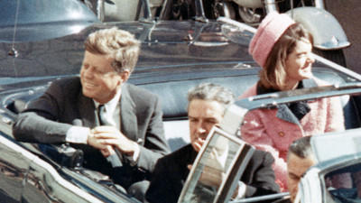
History can be a mystery
Each new discovery is evidence to help us understand the past.
Why did an event happen?
What happened to a group of people or a person?
Why do we celebrate or remember certain days?

Slide 13
What if History is Before Science or Not Scientific?
What if the History is Before Science or Not Scientific?
Blamed it on the GODS!!!
Example: Thunder was the Gods showing their anger
Developed Stories to explain the unexplainable
“Creation Myths”

Slide 14
How does history help society?
Become informed citizens
Become better critical thinkers
Learn from the mistakes of the past

