Slide 1
Warm-up
Recall: What were the ACTS of war? List them.

Slide 2
Unit 4: Lesson 4
Declaring Independence

Slide 3
Declaring Independence
LESSON 3
Big Idea
The colonies formally declared their independence from Great Britain.
Main Ideas
Thomas Paine’s Common Sense led many colonists to support independence.
Colonists had to choose sides when independence was declared.
The Declaration of Independence did not address the rights of all colonists.

Slide 4
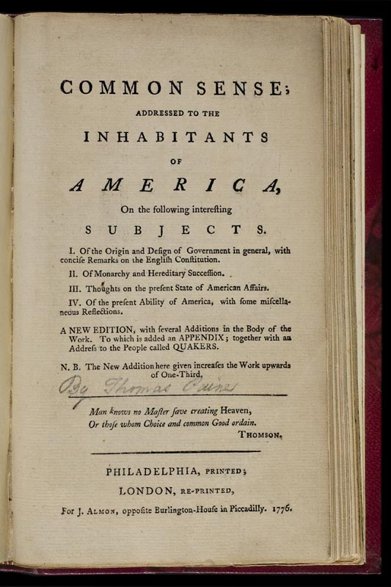
Paine’s Common Sense
Main Idea 1
Thomas Paine’s Common Sense led many colonists to support independence.
Common Sense: a forty-seven-page pamphlet written by Thomas Paine, published in January 1776
Urged separation from Great Britain
Argued that citizens, not monarchs, should make laws
Argued for economic freedom and the right to military self-defense
Cried out against tyranny, the abuse of government power
Reached a wide audience, selling some 500,000 copies

Slide 5
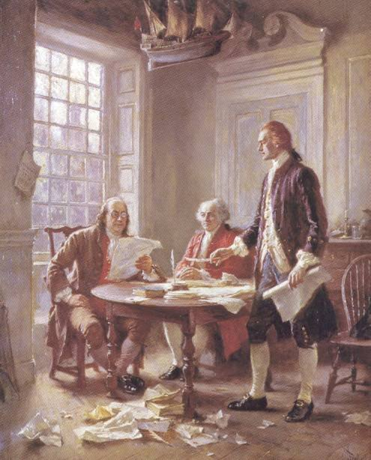
Independence Is Declared
Main Idea 2
Colonists had to choose sides when independence was declared.
A New Philosophy of Government
Many colonial leaders agreed with Thomas Paine’s ideas.
Second Continental Congress created a committee in June 1776 to write a document declaring independence.
Thomas Jefferson was main author.
Declaration of Independence formally announced break with Great Britain.
Approved on July 4, 1776.
https://www.youtube.com/watch?v=VIpACJRnZZE
continued…

Slide 6
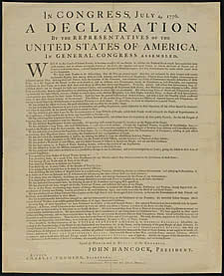
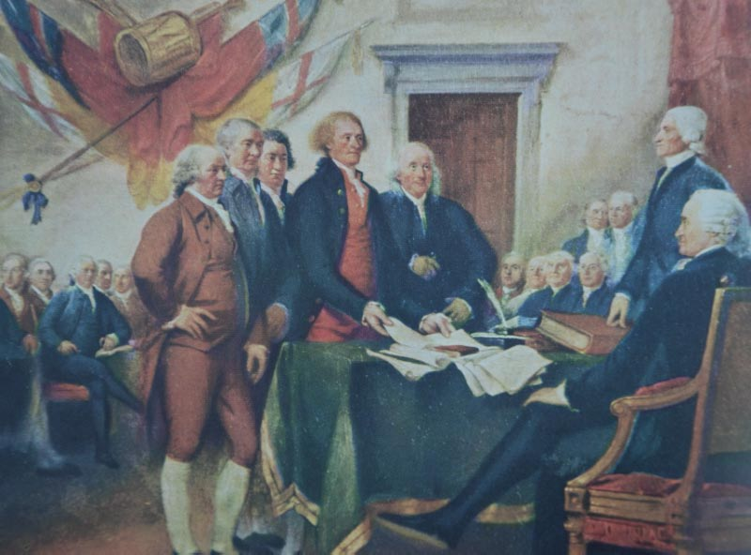
The Declaration of Independence
Declaration has 4 major parts
Preamble, or intro
Next 2 sections-
Humans born with natural rights… life, liberty, property
Job of government to protect, citizens duty to overthrow if not
Describes charges against crown proving their need for independence
Last section- proclaims the existence of new nation
Notes:
The Muppets Reenact the Continental Congress- (7:53) (painting)
declaration of independence – story of us (4:00) (doc)

Slide 7
Choosing Sides
Patriots
Patriots chose to fight for independence.
About 40 to 45 percent of Americans were Patriots.
Loyalists
Loyalists, sometimes called Tories, remained loyal to Britain.
About 20 to 30 percent of Americans were Loyalists.
Neutral
About 25 percent of Americans remained neutral.

Slide 8
Lesson 3
Unfinished Business
Main Idea 3
The Declaration of Independence did not address the rights of all colonists.
Declaration ignored many colonists, despite “all men are created equal”:
Did not address the rights of women
Did not recognize the rights of enslaved African Americans
Did not address the rights of Native Americans to life, liberty, or property

Slide 9
Lesson 3
Main Idea 3
Soldiers
More than 230,000 soldiers served in the Continental Army.
145,000 enlisted in local militias.
African Americans
First banned from serving, but when the British promised freedom to any slave who fought on their side, the Continental Army began to allow free African Americans to serve.
Woman
Ran farms and businesses
Helped by raising money for supplies or by making clothing
Served as messengers, nurses, and spies
Some dressed as men and fought.

Slide 10
Exit Ticket: Common Sense Analysis
Go to Google Classroom
Download and submit the Common Sense analysis

