Slide 1
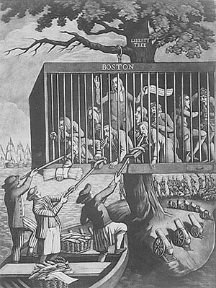
Warm-Up
Analyze the political cartoon.
1) What is the cartoon showing?
2) Explain the imagery (what is going on, explain each part and what it symbolizes).

Slide 2
Unit 4: Lesson 2
The Revolution begins

Slide 3
LESSON 2
The Revolution Begins
Big Idea
The tensions between the colonies and Great Britain led to armed conflict in 1775.
Main Ideas
The First Continental Congress demanded certain rights from Great Britain.
Armed conflict between British soldiers and colonists broke out with the “shot heard ’round the world.”
The Second Continental Congress created the Continental Army to fight the British.
In two early battles, the army lost control of Boston but then regained it.

Slide 4
First Continental Congress
Main Idea 1
The First Continental Congress demanded certain rights from Great Britain.
The First Continental Congress was a meeting in Philadelphia, in June of 1774, of delegates from all colonies except Georgia.
Delegates halted trade with Britain and alerted the colonial militia to prepare for war.
They drafted a Declaration of Rights that included the right to “life, liberty, and property.”
Also banned all trade with Britain until they complied
All colonies formed militias (colonial volunteer armies)
Colonists who chose to fight for independence from Britain became known as Patriots.

Slide 5
“Shot Heard ‘round the World”
Main Idea 2
Armed conflict between British soldiers and colonists broke out with the “shot heard ’round the world.”
The Ride of Paul Revere
Massachusetts governor, Thomas Gage, sent 6,000 British soldiers to seize weapons at Concord.
April 18, 1775, Dr. Joseph Warren is out for a walk when he spots the Redcoats. Warren rushes to warn Paul Revere and William Dawes (Sons of Liberty). Paul Revere, Dawes, and a few others rode to warn colonists.
Sam Adams and John Hancock are arrested in Lexington
Revere is caught and arrested mid-ride
Dawes is the only one to actually warn others
Local militia, minutemen, (men that could be ready in a minutes notice) readied for battle.
Battles at Lexington and Concord
April 19, 1775– 700 British soldiers arrived in Lexington and colonists fired the “shot heard ‘round the world.”
British Redcoats continue on to Concord but are forced to retreat back to Boston. Their red uniforms made an easy target for Patriot marksmen.

Slide 6
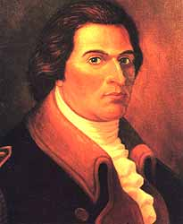
More Military Action
Shortly after…
Capt. Benedict Arnold of Connecticut militia ordered to take Fort Ticonderoga on Lake Champlain
Ethan Allen & Vermont’s militia given same order
Join together become “Green Mountain Boys”
Catch Brits by surprise
Take fort on 10 May 1775
In Massachusetts…
Colonial militia’s numbers grow to 20,000
For weeks the 2 armies nervously wait to see what happens next
Colonel Benedict Arnold
https://www.youtube.com/watch?v=SLfckzsa5Cc

Slide 7
Lesson 2
Second Continental Congress
Main Idea 3
The Second Continental Congress created the Continental Army to fight the British.
Continental Army
Congress created the Continental Army.
Named a Virginian, George Washington, to command army and prepare for the war
Second Continental Congress
Delegates from twelve colonies met in Philadelphia in May 1775.
Some called for peace, others for war.
Compromised—created army but also sent Olive Branch Petition to King George

Slide 8
Early Battles
Main Idea 4
In two early battles, the army lost control of Boston but then regained it.
Battle of Bunker Hill
Patriots attacked British at Fort Ticonderoga on May 10, 1775, to seize large supply of weapons.
June 16, 1775, Colonel William Prescott, leader of militia, moves militia to Bunker and Breeds Hill
Orders militia “Don’t fire until you see the whites of their eyes!”
Army of 2,400 Redcoats fought 1,600 Americans at the Battle of Bunker Hill.
Americans forced to retreat, but only after causing more than 1,000 British casualties.
Dorchester Heights
General Washington arrived in Boston and took command.
Cannons were brought in from Fort Ticonderoga.
In March 1776, Washington moved his army to Dorchester Heights and positioned the cannons on Nook’s Hill.
The British were forced to retreat from Boston.

Slide 9
Exit Ticket
Complete the Paul Revere Worksheet as your Ticket Out The Door
Too Late To Apologize?
https://www.youtube.com/watch?v=A_56cZGRMx4

