Slide 1
Warm Up
During the colonial period, the economic development of the South was most directly dependent on the labor of…
(a) factory workers (b) Irish immigrants
(c) wheat farmers (d) enslaved African

Slide 2
Unit 4: Lesson 1

Slide 3
LESSON 1
Conflict in the Colonies
Big Idea
Tensions developed as the British government placed tax after tax on the colonies.
Main Ideas
British efforts to raise taxes on colonists sparked protest.
The Boston Massacre caused colonial resentment toward Great Britain.
Colonists protested the British tax on tea with the Boston Tea Party.
Great Britain responded to colonial actions by passing the Intolerable Acts.

Slide 4
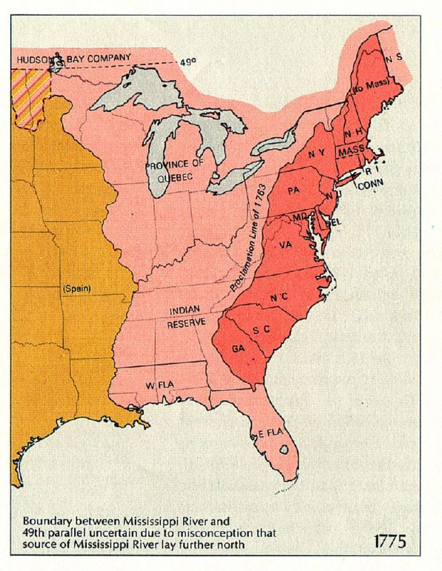
Relations with Britain
Post French & Indian War
Britain controlled Canada, NA to the Miss. River, and Caribbean
Proclamation of 1763- prohibited colonists from moving west of Appalachian Mountains.
Advantages for Britain
Allowed crown, not colonists to control expansion west
Conflicts w/ natives maybe avoided
Slow colonists moving away from colonies
Allow crown to control lucrative fur trade

Slide 5
Lesson 1
Great Britain Raises Taxes
Main Idea 1
British efforts to raise taxes on colonists sparked protest.
Taxation without Representation
Great Britain had to pay for the French and Indian War and for keeping troops in North America to protect the colonists.
Parliament passed the Sugar Act in 1764 to tax colonists to make them help pay costs.
Parliament’s actions upset many colonists.
Colonists believed there should be no taxes without representation in Parliament.
Samuel Adams, a colonial leader, set up the Committees of Correspondence to protest.

Slide 6
Lesson 1
Sugar Act
Sugar Act of 1764
Lowered tax on imported molasses/Sugar
Idea was to lower taxes to discourage smuggling
Also allowed British to seize goods from smugglers without going to court

Slide 7
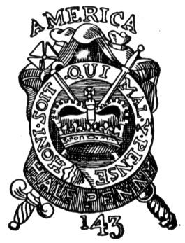
Stamp Act
Stamp Act of 1765
Colonists had to pay for official stamp, or seal, on purchase of paper items.
Immediate protests
“Sons of Liberty” sometimes used violence.
Stamp Act Congress of 1765 declared the tax a violation of colonial rights.
Repealed in 1766

Slide 8
The Repeal of the Stamp Act
March 1766- Parliament repeals Stamp Act
Colonists win battle, but war far from over
Same day though passed another Act
The Declaratory Act of 1766
Says Parliament has right to tax and make all decisions regarding British colonies

Slide 9
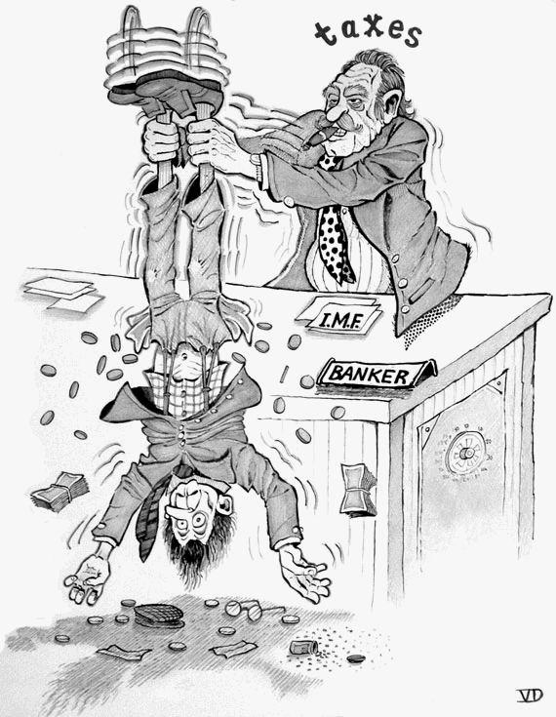
Townshend Acts
Townshend Acts of 1767
Duties on glass, lead, paints, paper, and tea
Writs of assistance used to enforce these acts.
Colonists boycotted British goods.
Sons of Liberty attacked houses of customs officials.
British troops sent in 1768.

Slide 10
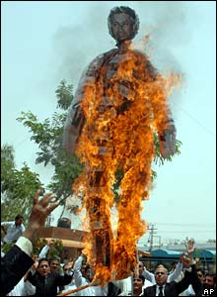
Protesting the Stamp Act
Patrick Henry, member of Virginia House of Burgesses
Convinces them to act
Pass a resolution, or formal expression of opinion against British tax and granted colonial legislature authority to tazx
Sam Adams in Boston starts “Sons of Liberty”
Took to streets to protest Stamp Act
Burned effigies- Rag figures representing tax collectors
Raided and burned homes of royal officials
Marched in the streets

Slide 11
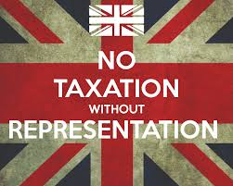
Exit Ticket
Foreshadow: What do you see the colonists doing next regarding the taxes?

