Slide 1
Unit 1: Lesson 2: Europeans Reach America

Slide 2
LESSON 2
Europeans Reach the Americas
Big Idea
Christopher Columbus’s voyages led to new exchanges between Europe, Africa, and the Americas.
Main Ideas
Christopher Columbus sailed across the Atlantic Ocean and reached a continent that was previously unknown to him.
After Columbus’s voyages, other explorers sailed to the Americas.

Slide 3
Lesson 2
Columbus Sails across the Atlantic
Main Idea 1
Christopher Columbus sailed across the Atlantic Ocean and reached a continent that was previously unknown to him.
Christopher Columbus, heard stories of great wealth in Asia and wanted to seize those riches for his own benefit.
He persuaded King Ferdinand and Queen Isabella of Spain to pay for an expedition across the Atlantic in search of a Northwest Passage.
On August 3, 1492, Columbus set sail across the Atlantic with three ships; the Niña, Pinta, and Santa Maria.
On October 12, 1492, he reached the Americas.
continued…

Slide 4
Lesson 2
Columbus in the Americas
Columbus and his crew landed in the Bahamas, on an island he named San Salvador.
He called the native people Indians because he thought he was in the Indies.
Columbus was interested in gold, not the culture of the native people.
He made three more voyages to the Americas.
The impact of Columbus’s voyages on the world was not realized until years after his death
Main Idea 1
continued…

Slide 5
Lesson 2
Main Idea 1
Impact of Columbus
Changed the way Europeans thought of the world and their place in it.
Began a new era of interaction between Europe and the Americas.
Created conflict as countries vied to add lands to their empires.
In 1493 Pope Alexander VI, from Spain, decreed the Line of Demarcation through the Atlantic Ocean that allowed Spain to claim all lands west of the line.
Portugal and Spain then signed an agreement, the Treaty of Tordesillas, which moved the Line of Demarcation 800 miles further west.

Slide 6
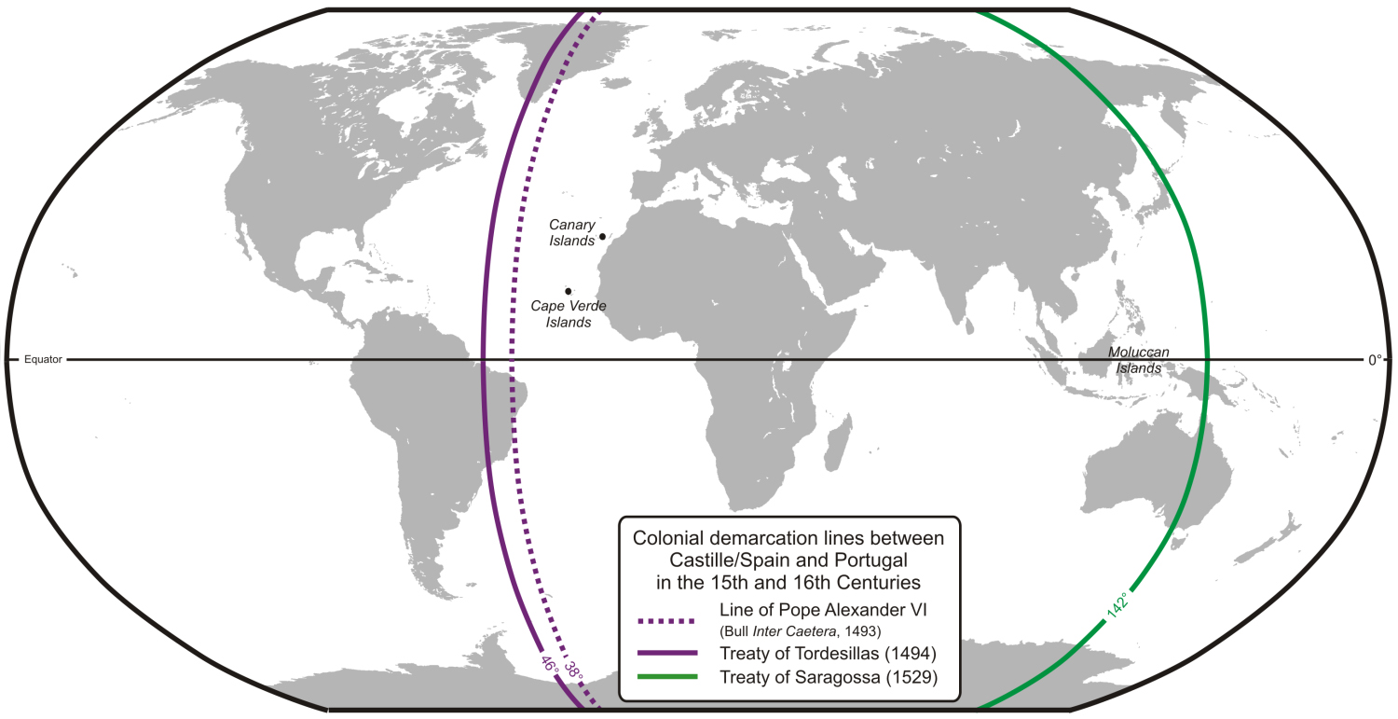

Slide 7
Lesson 2
Other Explorers Sail to the Americas
After Columbus’s voyages, other explorers sailed to the Americas.
Vespucci
America was named for Amerigo Vespucci, who sailed to South America in 1501.
Balboa
Vasco Núñez de Balboa crossed Central America to discover the Pacific Ocean.
Magellan
Ferdinand Magellan headed an expedition in 1519 that eventually circumnavigated, or sailed around, the world.
continued…

Slide 8
Lesson 2
The Columbian Exchange
Explorers brought plants, animals, and diseases to the “New World” of the Americas and brought back plants and animals to the “Old World”—Europe, Asia, and Africa.
The Columbian Exchange is the name given to this transfer of plants, animals, and diseases between Europe and the Americas.
Explorers brought horses, cattle, pigs, and grains such as barley and wheat to the Americas.
Europeans took back such American plants as corn, tomatoes, tobacco, and cocoa.
Main Idea 2

Slide 9
