Slide 1
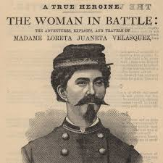
Warm-up: Spiral Review
What were women’s role in the war?
Who created the Red Cross?

Slide 2
The Civil War: 1861-1865
7-8 The Way to Victory

Slide 3
The Tide of War Turns
LESSON 8
Big idea
Union victories in 1863, 1864, and 1865 ended the Civil War.
Main Ideas
The Union tried to divide the Confederate Army at Fredericksburg, but the attempt failed.
The Battle of Gettysburg in 1863 was a major turning point in the war.
During 1864, Union campaigns in the East and South dealt crippling blows to the Confederacy.
Union troops forced the South to surrender in 1865, ending the Civil War.

Slide 4
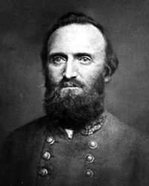
Lesson 5
Fredericksburg and Chancellorsville
Main Idea 1: The Union tried to divide the Confederate Army at Fredericksburg, but the attempt failed.
Ambrose Attacks
General Ambrose E. Burnside sent to replace McClellan as leader of Army of the Potomac.
Strategy: attack Richmond by way of Fredericksburg
Burnside caught Lee by surprise but delays left Lee enough time to organize and entrench Confederate forces.
The Union lost the battle and suffered heavy casualties.
Hooker Attacks
General Joseph Hooker sent to replace Ambrose as leader of Army of the Potomac.
Strategy: outflank the Confederate army at Fredericksburg
Hooker instead hesitated and took a defensive position at Chancellorsville where Union forces were overwhelmed by both Lee and Stonewall Jackson.
The Confederates win a major victory.

Slide 5
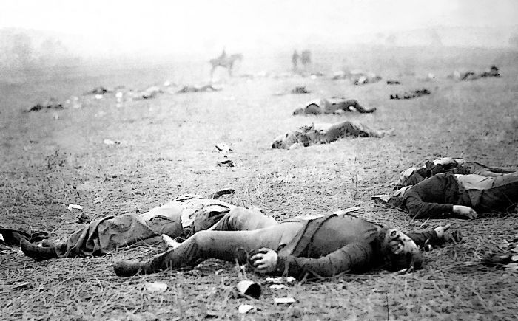
Lesson 5
Battle of Gettysburg
Main Idea 2: The Battle of Gettysburg in 1863 was a major turning point in the war.
Largest and bloodiest battle of Civil War
More than 51,000 soldiers were killed, wounded, captured, or went missing in three days.
It was an important victory for the Union because it stopped Lee’s plan of invading the North
https://www.youtube.com/watch?v=7ALyq3seK2g
51,000 Deaths!!!
continued…

Slide 6
First Day
Lee’s forces were gathered at Gettysburg, Pennsylvania, on July 1, 1863.
Ran into Union forces under General George G. Meade, beginning the Battle of Gettysburg
Union took up defensive positions
Second Day
Lee ordered attack on Union troops on Little Round Top.
Both sides fought viciously for control.
Union forces held off Confederates.
Pickett’s Charge
Lee planned attack on center of Union line.
General George Pickett led 15,000 men in Pickett’s Charge, a failed attack on Cemetery Ridge.
Lee began planning retreat to Virginia.
continued…

Slide 7
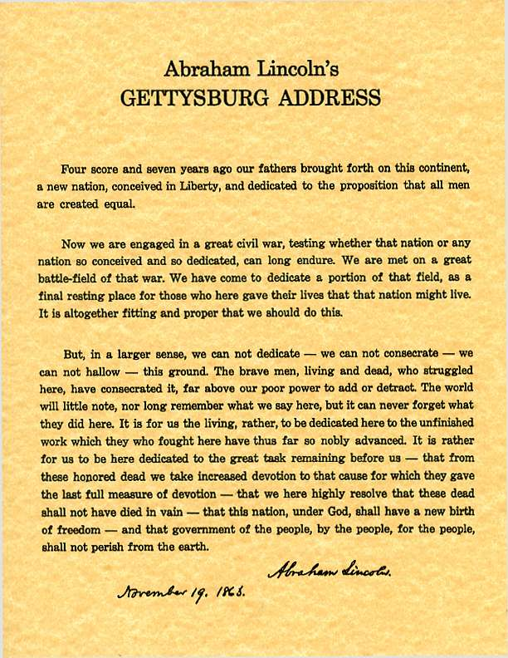
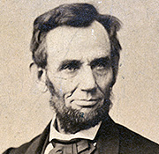
Aftermath of Gettysburg
Gettysburg was turning point of war—Lee would never again attack in the North.
Some 23,000 Union and 28,000 Confederate casualties
Victory came the day before the Union capture of Vicksburg.
Britain and France refused to aid South after Gettysburg.
The Gettysburg Address
Lincoln gave 2-minute speech called Gettysburg Address at dedication of the Gettysburg battlefield cemetery.
He praised bravery of Union soldiers and renewed commitment to winning the war.

Slide 8
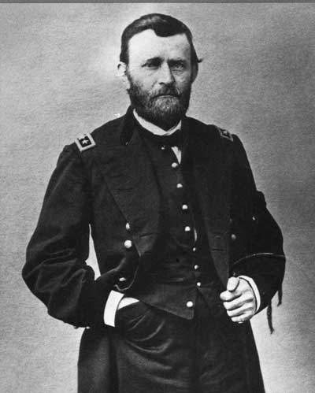
Lesson 5
Union Campaigns Cripple the Confederacy
Main Idea 3: During 1864, Union campaigns in the East and South dealt crippling blows to the Confederacy.
Lincoln was impressed with Grant’s victories; gave him command of Union army.
Grant forced Lee to fight series of battles in Virginia that stretched Confederate soldiers and supplies to limit.
Wilderness Campaign in the East
Wilderness Campaign: series of battles designed to capture Confederate capital of Richmond, Virginia, in 1864.
Grant kept moving toward Richmond but suffered huge casualties.
Failure to capture Richmond by election of 1864 distressed Lincoln.
continued…

Slide 9
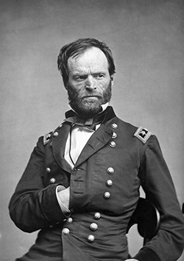
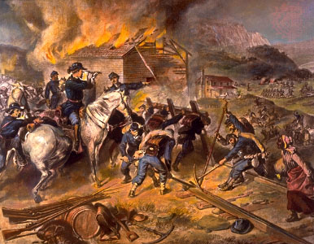
Sherman Strikes the South
Lincoln needed victory for Union army to help him win reelection in 1864.
General William Tecumseh Sherman’s campaign to destroy South’s railroads and industries provided Lincoln his victory.
Sherman’s 100,000 troops marched south from Tennessee in spring of 1864 to capture Atlanta, Georgia, in September, and Savannah in December.
Sherman practiced total war, destroying civilian and economic resources, in the hope of ruining the South’s economy and ending its ability to fight. He hoped this would speed the end of the war.
https://www.youtube.com/watch?v=5c-aOnzB92I

Slide 10
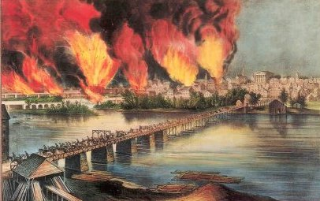
The South Surrenders
Main Idea 4: Union troops forced the South to surrender in 1865, ending the Civil War.
Grant broke through Confederate defenses at Petersburg, Virginia, and Lee retreated to Richmond on April 2, 1865
Confederates retreat to Richmond, the capital, and set it on fire before Grant could take control: known as “Burning of Richmond”
Fighting Ends
Grant surrounded Lee’s army.
Lee surrendered to Grant at the small town of Appomattox Courthouse, Virginia, on April 9, 1865.

Slide 11
Effects of the War
Civil War had deep and long lasting effects.
Almost 620,000 Americans killed
The South’s defeat ended slavery.
Majority of former slaves had no homes or jobs.
Southern economy was in ruins.
Tremendous amount of hostility remained.
Many questioned how the United States could be united again.
https://www.youtube.com/watch?v=D2B7QzAR6XI

Slide 12
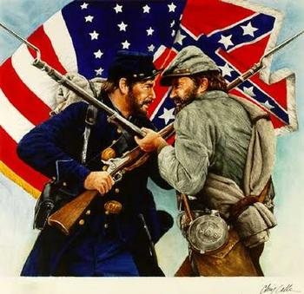
Exit Ticket
What were the results of the Civil War?

