Slide 1
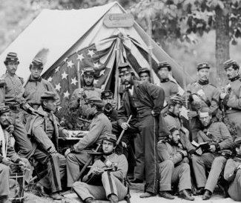
Warm-Up: Spiral Review
Describe “who” the average soldier was? (age, job, etc)

Slide 2
The Civil War: 1861-1865
7-7 “Life During the Civil War”

Slide 3
The Average Soldier
Notes:
This slide illustrates the organization of armies during the Civil War. Most men were privates and part of a much larger army.
On the left you can see how soldiers were grouped to make an army. 1 company = 100 men.
On the right you can see the hierarchy of rank.
Discussion: Do you think that most men were noticed?
How do you think privates were treated?
How do you think generals were treated?

Slide 4
The Average Soldier
Notes:
Enlisting/signing up to fight --the men came from factories and farms, North & South to fight in the Civil War

Slide 5
The Average Soldier They were old and young, but mostly young…
Notes:
Discussion:
Why do you think the Civil War is sometimes called the “Boys’ War?”
How many Union Soldiers were under 16?
How many soldiers were between 16 and 23?
How many were over 23?
Do you think most soldiers in the Confederate army would have been older or younger? Why?

Slide 6
The Average Soldier
Notes:
The average Yank or Reb was white, native-born, farmer, protestant, single, between 18 and 29. He stood about 5 feet 8 inches tall and weighed about 143 pounds. Most soldiers were between the ages of 18 and 39 with an average age of 25.
Slang – Reb and Yank may be terms that you have not yet discussed with your students.
Reb = rebel, confederate, or southern soldier
Yank = yankee, federal, union, or northern soldier

Slide 7
Why They Fought
Notes:
Men on both sides were inspired to fight by patriotism, state pride, the chance for adventure, or steady pay. The common Union soldier tended to fight to preserve the Union while the common Confederate soldier tended to fight to defend his home.
Discussion:
Why would a Confederate soldier be defending his home and a Union soldier not be?
Answer information - the war was mainly fought in the South. Union troops initially moved South to put down the rebellion. In the North, Maryland, Kentucky, Missouri and Pennsylvania saw major battles.
Imagine you are one of the men in this picture, what are you doing right now? How do you feel physically? How do you feel emotionally? Are you away from your family or loved ones? What might you do to pass the time?

Slide 8
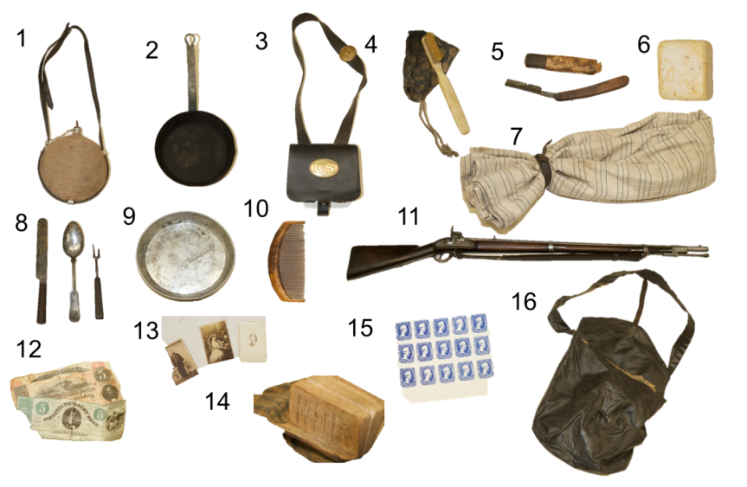
What They Carried
Notes:
Canteen
Pan
Cartridge box (Union)
Tooth brush
Razor
Soap
Blanket
Silver wear
Plate
Comb
Musket
Money (Confederate)
Photographs
Bible
Stamps (Confederate, Jefferson Davis prints)
Haversack (Union)

Slide 9
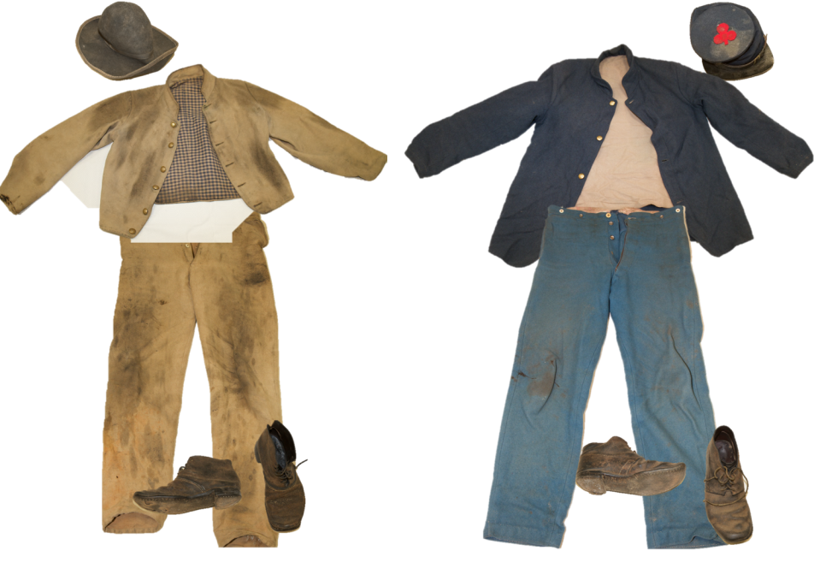
What They Wore
Notes:
On the left - Confederate:
Slouch hat
Shell Jacket
Pants
Brogans (shoes)
On the right - Union:
kepi
Sack Coat
Pants
Brogans (shoes)

Slide 10
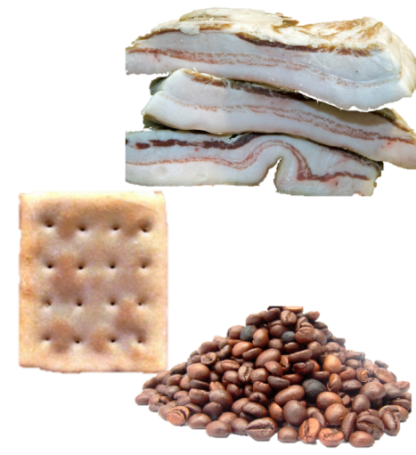
What They Ate
Salt pork, bacon, or beef
Soft bread, flour, cornmeal, or hardtack
Beans or peas
Rice or hominy
Coffee
Tea
Sugar
Vinegar
Molasses
Notes:
Discussion:
How do you think this tasted?
Do you think there was always enough food?

Slide 11
Where They Slept
Notes:
Loudon Valley Dec 9 Pioneers Hotel 20 Regt Con Vol Virginia
“This is the drawing of our log Cabin looks natural all think made of logs & covered with flies or canvas don’t leak much the dark place in the middle is rubber blankets the canvas is not large enough we don’t have any windows light comes through the canvas…..”
Discussion:
What do you think the soldiers stayed in during the warmer months? Answer information – soldiers slept in tents or on the ground
What do you think it was like inside the winter quarters?
Answer information – winter quarters, while looking cozy, were damp and cold. Disease flourished as camp sites became unsanitary with large numbers of men and their waste occupying small areas.
Do you think it was warm or cold?
Why do you think they built such permanent places to stay in the winter and not just use tents like in the summer?
Answer information – there were very few battles in the winter, it was almost impossible to travel once the roads froze. Just like how battles mainly happened during the day they also mainly happened during the warmer months because it was just too logistically and physically difficult.

Slide 12
How They Communicated
Notes:
All who knew how to write, wrote letters. During the Civil War letter writing was the only method of personal communication.
Discussion:
Do you think soldiers looked forward to getting mail?
Do you think the soldiers got homesick?

Slide 13
When They Weren’t Fighting
“first thing in the morning is drill, then drill, then drill again. Then drill, drill, a little more drill. Then drill and lastly drill. Between drills, we drill….”
– Union Soldier
Notes:
Soldiers spent the majority of their time in camp drilling, not on the battlefield.
Discussion:
Why were they always drilling?
Answer information - Most of the time soldiers were not fighting battles, rather they were in camp or marching. Drilling kept the men busy during the down-time and prepared them so that they could maneuver under fire.

Slide 14
Life and Death

Slide 15
Life and Death
Disease and Hygiene
Everyone and everything smelled during the Civil War.
Dysentery (diarrhea) was the greatest killer during the Civil War.
Of the more than 620,000 soldiers who died in the war, more than 400,000 died of sickness and disease.
Notes:
Discussion:
According to this information, did bullets or sickness kill most of the soldiers?

Slide 16
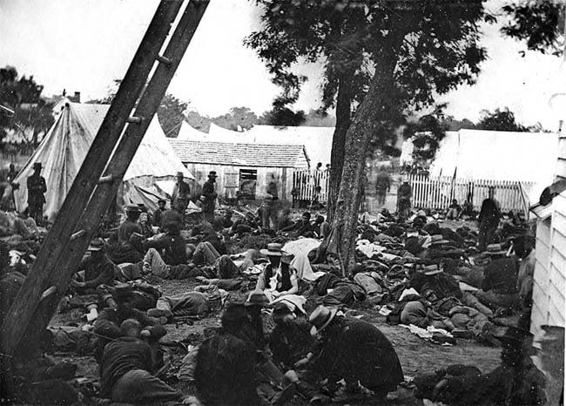
Lives of Soldiers: The Reality of War
In both, N & S, civilians and soldiers suffered throughout the war
At start, men on both sides rushed to enlist
Not so much the case later
Most of time, soldiers lived in camps
Had pleasant moments
Songs, stories, letters, games, etc.
Mostly dull… drills, bad food, marches and rain
Reality of war not far away though
Suffered terrible losses
New weapons fired w/ greater accuracy & distance
Med facilities overwhelmed w/ casualties & wounded
After Shiloh some waited in rain for 24+ hours waiting for treatment!!!
Many died waiting in agony
b/c of horrors, many deserted
1 of 11 Union soldiers
1 of 8 Rebs
Rebs faced extreme lack of food and supplies
Notes:
Civil War Medicine; The Civil War in Cumberland County, PA (6:22)
Gruesome Reality of Civil War Medicine (3:07) (on HORRORS star)

Slide 17
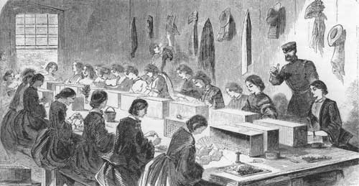
Women in the War: Background
b/c of war, many women took on new roles
Teachers, office workers, salesclerks, gov’t workers, factories, farms, etc.
Suffered losses of husbands, fathers, brothers, and sons
Performed many jobs to help cause
Rolled bandages, wove blankets, made ammo, etc.
Children helped too
Collected food, clothing, medicine, raised $$$, etc.
Notes:
The Civil War in Four Minutes: Women (4:11)

Slide 18
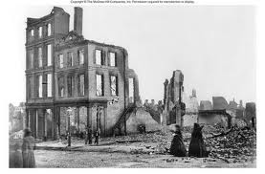
Women in the War: Life at Home
N saw war from distance
Most battles in South
News and letters kept them up to date
Every woman who stayed home suffered
Dailey life changed but…
N faced little disruption
S was drastically changed though
Battles in back yard and blockade disrupted life
If in path of war, lost homes and crops
War rages on, shortages become common
South ran out of everything
Feed for animals, salt for curing meat, clothing, medicine, and shelter
What had went to soldiers first, too!

Slide 19
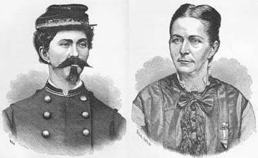
Dude looks like a Lady!!!
Loretta Janeta Valázquez dresses as man to fight for Confederacy at Bull Run and Shiloh

Slide 20
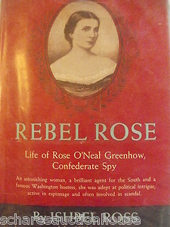
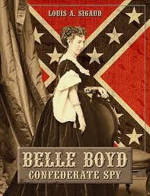
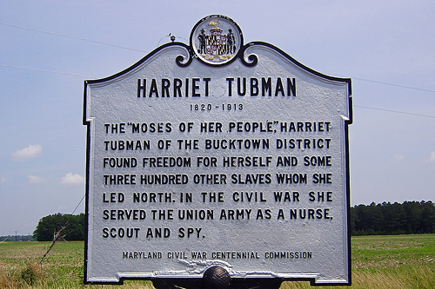
Women in the War: Spies Like Us
Some woman became spies
Harriet Tubman spied for N
Rose O’Neil Greenhow
Entertained Union leaders in N & sent info to the S
Later caught, convicted of treason, & exiled
Belle Boyd informed Rebs of Union mvmts in VA
Some even became soldiers!!!
Loretta Janeta Valázquez
Fought for Rebs at 1st Battle of Bull Run & Shiloh
Later becomes a Reb spy
Notes:
The Role of Women in the Civil War (8:26)

Slide 21
Women in the War: Treating the Sick & Wounded
First time, Civil War saw women become nurses
By the 1,000’s
Drs. did not approve at first
Women too delicate
Considered it man’s work
Improper for women to tend to bodies of unknown men
Dorothea Dix
Organized many women in North as nurses
Clara Barton
Became famous for her work w/ the wounded in North
Later founds “The American Red Cross”
Sally Tompkins
Est hospital for wounded soldiers in South
Nursing hard work
Women did a remarkable job
Ironically leads to stereotype of women only as nurses, not men!
Notes:
Clara Barton & Civil War Medicine (4:40)

Slide 22
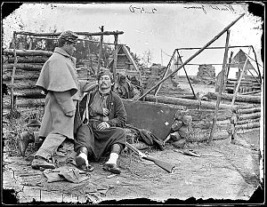
Essential Question: Exit Ticket
How did women play an important role in the war? Name one woman and her contribution.

