Slide 1
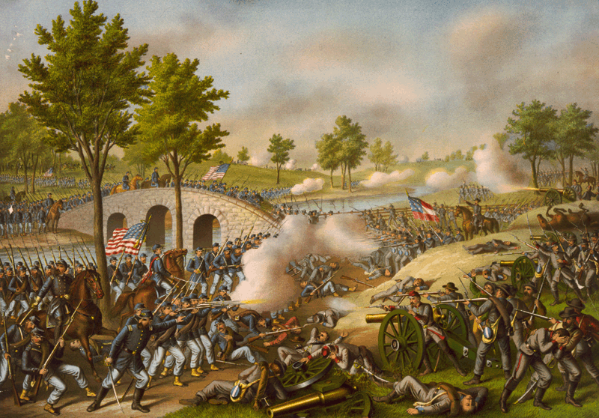
Warm-Up: Spiral Review-
What effect did the Battles of Richmond Antietam have on the war?

Slide 2
The Civil War: 1861-1865
A Call for Freedom

Slide 3
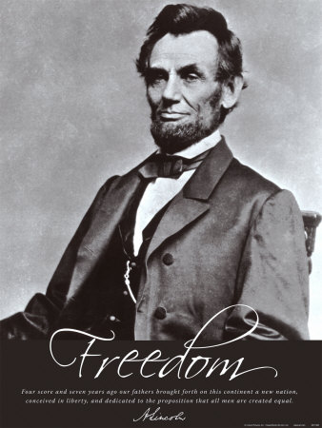
Emancipation
From the start…
North’s main goal was to preserve Union not destroy slavery
His personal wish “all men everywhere could be free.”
BUT…
“ If I could save the Union without freeing any slave, I would do it; and if I could save it by freeing all the slaves, I would do it; and if I could save it by freeing some and leaving others alone, I would also do that.”
Some in North believed slavery was helping the Rebels
Slaves raised crops and did heavy work in camps
To Yankees, anything that hurt slavery, hurt the Confederacy

Slide 4
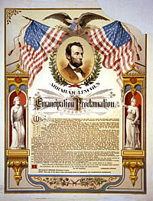
The Emancipation Proclamation
Lincoln knew what people thought, and wanted
Knew that going against slavery would make British's & French not want to support South
Became convinced slavery was helping South
Summer 1862- he had decided to emancipate, or free slaves
22 Sept. 1862-
5 days after Union win at Antietam Lincoln announces plan
1 January 1863-
Lincoln signs document freeing all slaves within Confederacy

Slide 5
Effects of the Proclamation
Confederacy refused to abide by it
Lincoln knew slaves would hear about it
Hoped it would encourage slaves to rise up or runaway
Even before it 100,000 left for Union lines
Despite limitations, Northern African Americans cheered it on
Frederick Douglas called it, “…the greatest event of our nation’s history.”
1864- Congress, not to be outdone, issues 13th Amendment
Outlaws slavery in US
Ratified in 1865
This truly freed slaves
All had to do was get South back in the Union to force them to follow it!

Slide 6
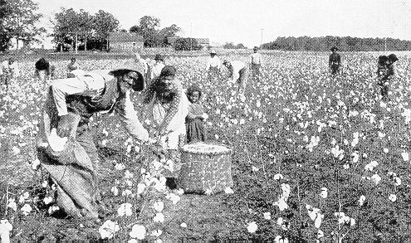
African Americans in South During War
Early on, Lincoln against African Americans in the Union Army
‘Emancipation’ would now allow it
When war began, 3.5 million slaves in south
30% of the total population
Most of it’s workforce
Worked on plantations, Iron, and slat mines
Worked as nurses too
By 1865- 1/6th had fled though
Possibility of revolt scared South
Why wouldn’t allow slaves to fight- afraid to give them guns
Near end, Confederacy desperate
Robert E Lee convinces Davis to allow it
Too late though
War ended before could get regiments up and trained
3.5 Million Slaves in Confederacy
*
30% of Confederacy’s Population
*
By 1865, 1/6th Flee to Union

Slide 7
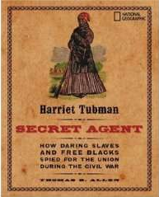
African Americans Helping the North
Different in North, but not much at first
Freed men not allowed to serve in Union Army
Disappointed many
Found other ways though
Union Navy allowed them though!
Served as guides and spies in South
Harriet Tubman was one of them!
Helped 100’s escape on Underground Railroad
Now use knowledge of trails and paths to help army and spied on rebels too!
1862- Congress passes law to allow them to fight in army !
Freed & runaways began signing up by the 1,000’s
By the end of the war, African Americans made up nearly 10% of the Union Army
200,000+ served and 37,000 had been killed
By fighting though, taking important step in helping themselves

Slide 8
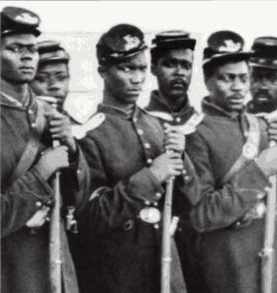
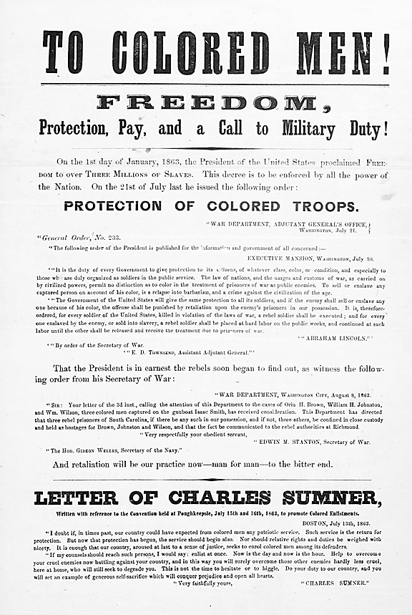
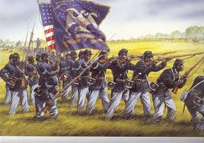
African American Soldiers
8:50-12:28
Organized into regiments
Separate from white regiments
White commanders
Less pay than whites at first, but protests led to equal pay by 1864!
Most famous, 54th Massachusetts
Lead charge on Charleston, SC
Were eventually beaten and lost over 50% of men, but bravery lead to respect for black regiments
Lincoln’s opponents criticized idea
South issued decries
All African Americans fighting would be taken into servitude
If African Americans were caught wearing uniforms they would be hung
Any white officer leading them would be hung

