Slide 1
Warm Up: How did we get to the point of secession? What happened at Fort Sumter to start the war?

Slide 2
The Civil War: 1861-1865
7-5 War in the East and West

Slide 3
The War in the East and West
LESSON 2
Big Ideas
Confederate and Union forces faced off in Virginia and at sea.
Fighting in the Civil War spread to the western United States.
Main Ideas
Union and Confederate forces fought for control of the war in Virginia.
The Battle of Antietam gave the North a slight advantage.
The Confederacy attempted to break the Union naval blockade.
Union strategy in the West centered on control of the Mississippi River.

Slide 4
Lesson 2
War in Virginia
Main Idea 1
Union and Confederate forces fought for control of the war in Virginia.
First major battle of Civil War in Virginia, in July 1861
Union army of 35,000 under General Irvin McDowell
Confederate army of 22,000 under General Pierre G. T. Beauregard
Clashed at Bull Run Creek near Manassas.
Additional 10,000 Confederates arrived
Confederate troops under General Thomas “Stonewall” Jackson held against Union advance
Confederates counterattacked
Terrified, Union troops drop everything & ran… right into the fleeing civilians
Confederates won First Battle of Bull Run, also known as the First Battle of Manassas
continued…

Slide 5
Lesson 2
Main Idea 1
More Battles in Virginia
General George B. McClellan was placed in charge of 100,000 soldiers, called the Army of the Potomac.
McClellan launched an effort to capture Richmond called the Peninsular Campaign. Stonewall Jackson launched an attack towards Washington, preventing Union reinforcements.
Confederate army in Virginia was under the command of General Robert E. Lee. Lee attacked Union forces in series of clashes called Seven Days’ Battles and forced Union army to retreat in June 1862.
Lincoln ordered General John Pope to march to Richmond.
Jackson’s troops stopped Pope’s army before it met up with the other Union army. The Second Battle of Bull Run, or Second Battle of Manassas, was fought in August 1862; Confederates again forced a Union retreat.
continued…

Slide 6
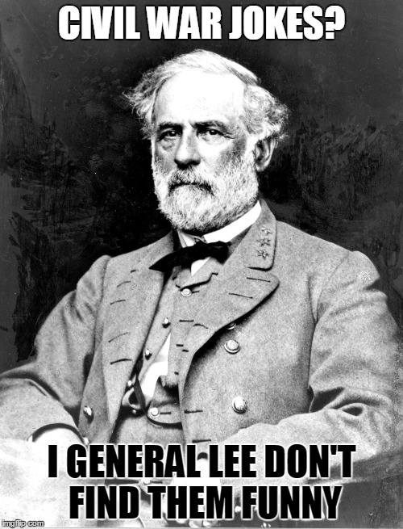
Lesson 2
Main Idea 1
Robert E. Lee
Born into wealthy Virginia family in 1807
Graduate of the U.S. Military Academy at West Point
Fought in Mexican-American War
Lincoln asked Lee to lead Union army at start of Civil War.
Lee declined and resigned from the Union Army to become a Confederate general.

Slide 7
Lesson 2
Battle of Antietam
Main Idea 2
The Battle of Antietam gave the North a slight advantage.
Confederate leaders wanted to follow Lee’s victories in Virginia with victory on northern soil.
Lee’s Confederate troops and McClellan’s Union army met along Antietam Creek in Maryland on September 17, 1862.
18 Sept. 1862- Union soldiers find a copy of Lee’s plans in field
The Battle of Sharpsburg or Battle of Antietam was the bloodiest single-day battle in U.S. history, with more than 12,000 Union and 13,000 Confederate casualties.
Also called the Battle of Sharpsburg
It was an important victory for the Union, stopping Lee’s northward advance.

Slide 8
Lesson 2
Breaking the Union’s Blockade
Main Idea 3
The Confederacy attempted to break the Union naval blockade.
The Union’s Naval Strategy
Union navy controlled the sea and blockaded southern ports.
The southern economy was hurt because the South was prevented from selling and receiving goods.
Some small, fast ships got through blockade, but the number of ships entering southern ports was reduced from 6,000 to 800 a year.
continued…

Slide 9
Clash of the Ironclads
When war began, the North did not have enough ships to cover 3500 miles coast line
Blockade Runners were Rebel ships that could run in and out of the blockade
The Confederacy turned to a new type of warship—ironclads, or ships heavily armored with iron.
The Confederacy Captured Union ship Merrimack, turned it into ironclad, and renamed it the Virginia.
Ironclads successfully attacked the wooden ships of the Union.
Met by a Union ironclad, the Monitor, in battle near Hampton Roads, Virginia, in March 1862 and it forced the Confederates to withdraw
Designed by John Ericsson
Had a revolving gun tower and thick plating
The Monitor’s success saved the Union fleet and continued the blockade.

Slide 10
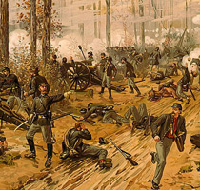
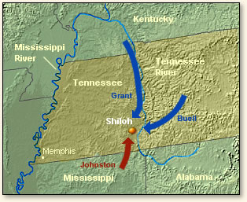
Union Strategy in the West
Main Idea 4
Union strategy in the West centered on control of the Mississippi River.
Ulysses S. Grant was commander of Union forces in West
Bold and restless, he wanted to attack.
Western campaign focused on taking control of Mississippi River.
Would cut off eastern part of Confederacy from food sources in West
Union could use bases along the Mississippi to attack communication and transportation networks.
Grant’s Army of Tennessee captured Confederate forts on Tennessee and Cumberland rivers in February 1862.
Both sides claimed victory in bloody two-day Battle of Shiloh in April 1862, but Grant’s forces had driven Confederates back into Mississippi.
continued…

Slide 11
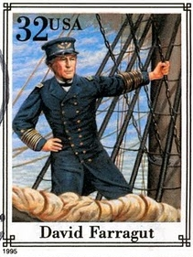
The Fall of New Orleans
U.S. Navy moved upriver to meet Grant, who was moving down the Mississippi.
First obstacle was the port of New Orleans—largest Confederate city and gateway to the Mississippi.
Fleet under Admiral David Farragut captured New Orleans in April 1862.
Farragut was of Spanish decent, grew up in the South but was loyal to the North.
He then took Baton Rouge, Louisiana, and Natchez, Mississippi.
continued…

Slide 12
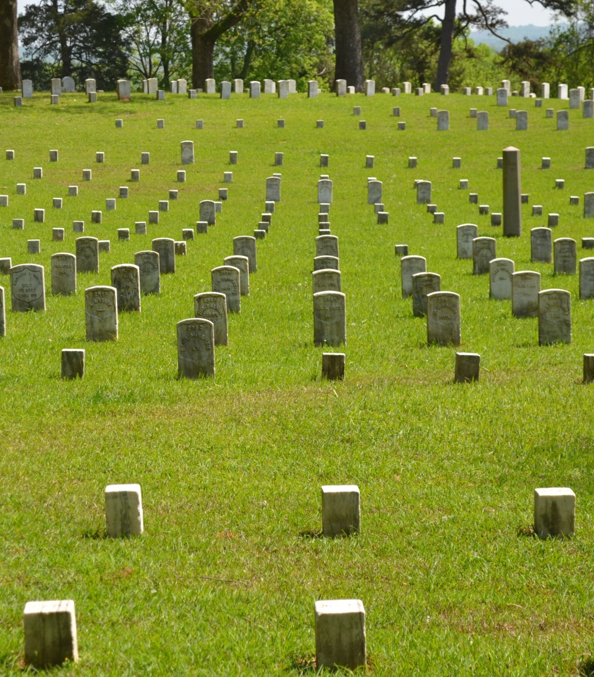
The losses at Shiloh were enormous. Together the two armies suffered 20,000 casualties!
“that was too shocking… too horrible to bear.”
~unnamed Confederate Soldier

Slide 13
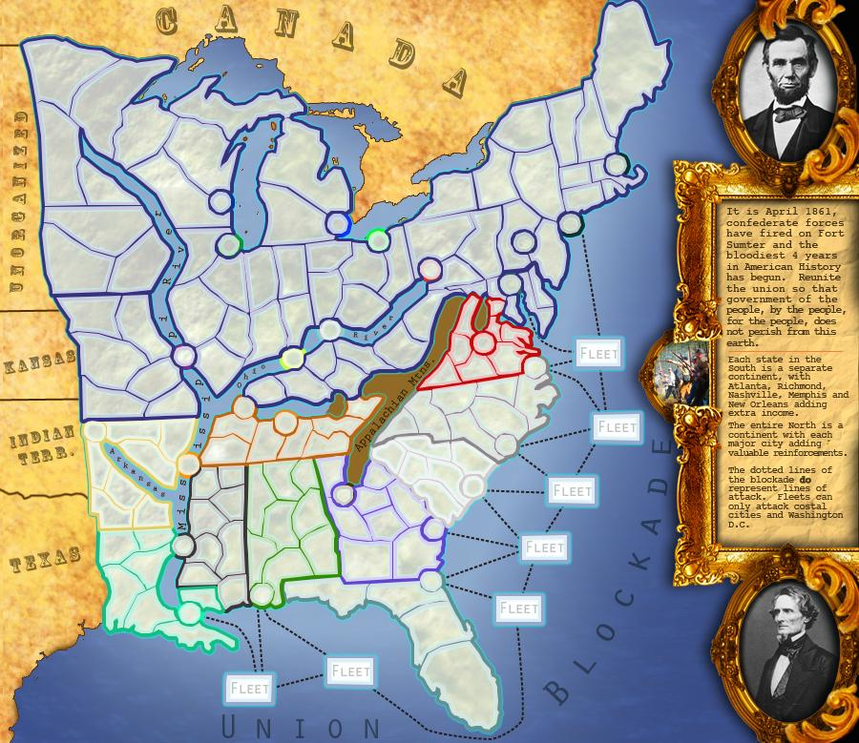
The Siege of Vicksburg
Farragut ordered surrender of strategic Vicksburg, Mississippi, in May 1863.
Location on 200-foot-high cliffs above the Mississippi made invasion nearly impossible.
Grant decided to starve the city into surrender; began Siege of Vicksburg in mid-May.
Facing starvation, city surrendered on July 4, 1863.
continued…

Slide 14
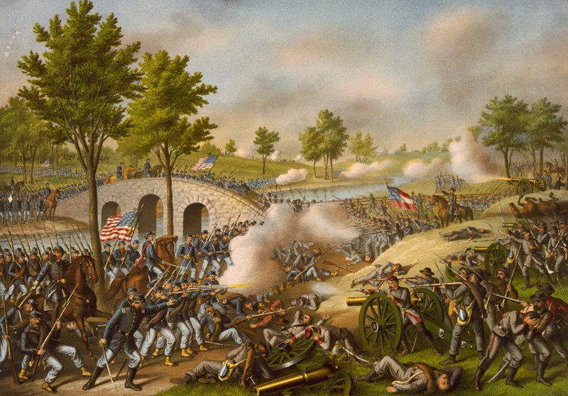
Exit Ticket
What effect did the Battles of Richmond and Antietam have on the war?

