Slide 1
Warm Up/Spiral Review
What effect did the Dred Scott ruling have on the relationship between the North and the South? What was the ruling?

Slide 2
A Nation Dividing: 1820-1861
7-4 “Secession and War”

Slide 3
The Nation Divides
LESSON 4
Big Ideas
The United States broke apart due to the growing conflict over slavery.
Main Ideas
The outcome of the election of 1860 divided the United States.
The dispute over slavery led the South to secede.
Following the outbreak of war at Fort Sumter, Americans chose sides.

Slide 4
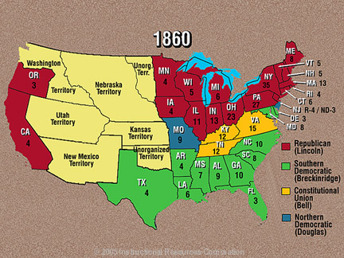
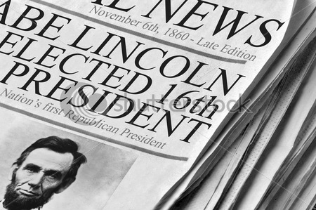

Slide 5
Lesson 4
Election of 1860
Main idea 1
The outcome of the election of 1860 divided the United States.
Northern Democrats chose Senator Stephen Douglas; Southern Democrats, Vice President John C. Breckinridge.
The Constitutional Union Party selected John Bell of Tennessee.
Republicans nominated Lincoln, who won with most votes of the free states.
Lincoln promised not to abolish slavery where it already existed.
The result angered southerners.
Lincoln had not campaigned in the South or carried any southern states in the election.
His name did not even appear on the Southern ballots.

Slide 6
Lincoln Takes Office
Lincoln inaugurated on March 4, 1861.
Opposed idea that southern states could leave the Union because they were unhappy with government’s position on slavery
Announced in inaugural address that he would keep all government property in the seceding states
Hoped that southern states would return to the Union
continued…

Slide 7
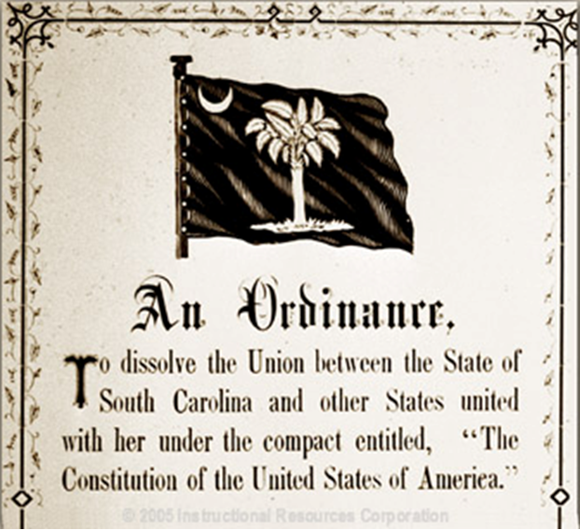
Lesson 4
The South Secedes
Main idea 2
The dispute over slavery led the South to secede.
Southerners’ Reactions
Lincoln insisted he would not change slavery in South, but would not let it expand.
People in South believed that their economy and way of life would be destroyed.
South Carolina legislature met to consider secession, formally withdrawing from the Union.
On December 20, 1860, South Carolina seceded, believing it had the right because it had voluntarily joined the Union.
continued…

Slide 8
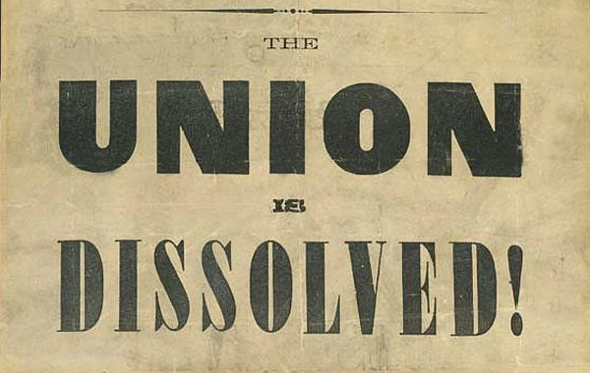
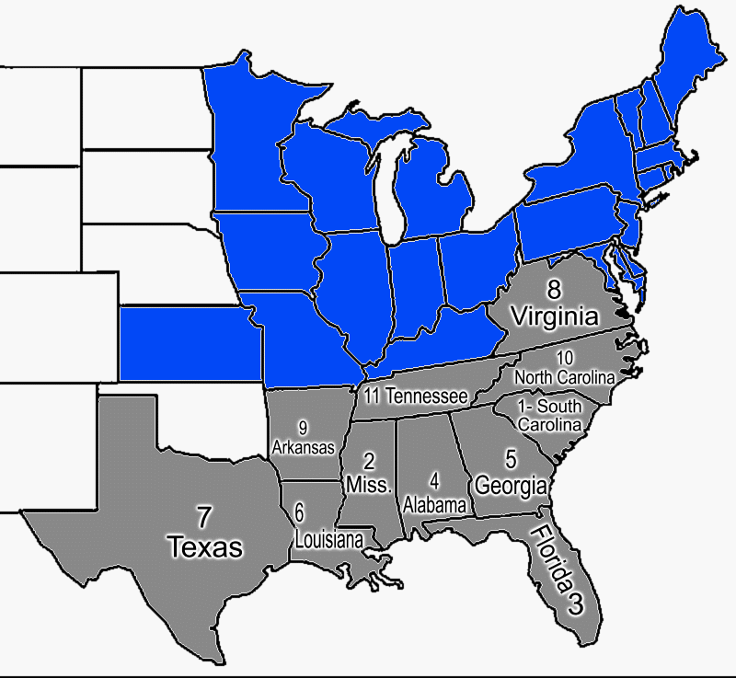
Confederate States of America
Senator John Crittenden proposed series of constitutional amendments hoping to satisfy the South by protecting slavery.
Lincoln believed there could be no compromise about the extension of slavery, and the plan was rejected.
In February of 1861, Mississippi, Florida, Alabama, Georgia, Louisiana, and Texas meet in Mobile, AL and joined South Carolina to form Confederate States of America.
Jefferson Davis of Mississippi was elected Confederate president.

Slide 9
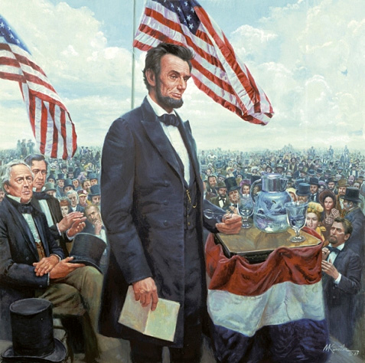
Presidential Responses
After reading this excerpt,
who would Lincoln say is to
blame for a Civil War?
Lincoln elected but not inaugurated yet (not for another month)
Buchanan still Pres!
2 months earlier…
Buchanan tells Congress South has no right to secede, but…
Had no power to stop them
(Lame Duck)
Many awaited Lincoln’s inauguration to see what say and do
What would VA, NC, KY, TN, MO, AK do as well?
Decided to stay, but decision not final!
If force used to bring back south, rest secede
Lincoln mixed toughness and peace in speech
Said secession would not be permitted, but pleaded w/ South to reconsider
Think of the consequences of your actions
"Plainly, the central idea of secession, is the essence of anarchy..."
"In your hands, my dissatisfied fellow-countrymen, and not in mine, is the momentous issue of civil war. The Government will not assail you. You can have no conflict without being yourselves the aggressors. You have no oath registered in heaven to destroy the Government, while I shall have the most solemn one to 'preserve, protect, and defend it'." -- March 4, 1861 - Lincoln's First Inaugural Address

Slide 10
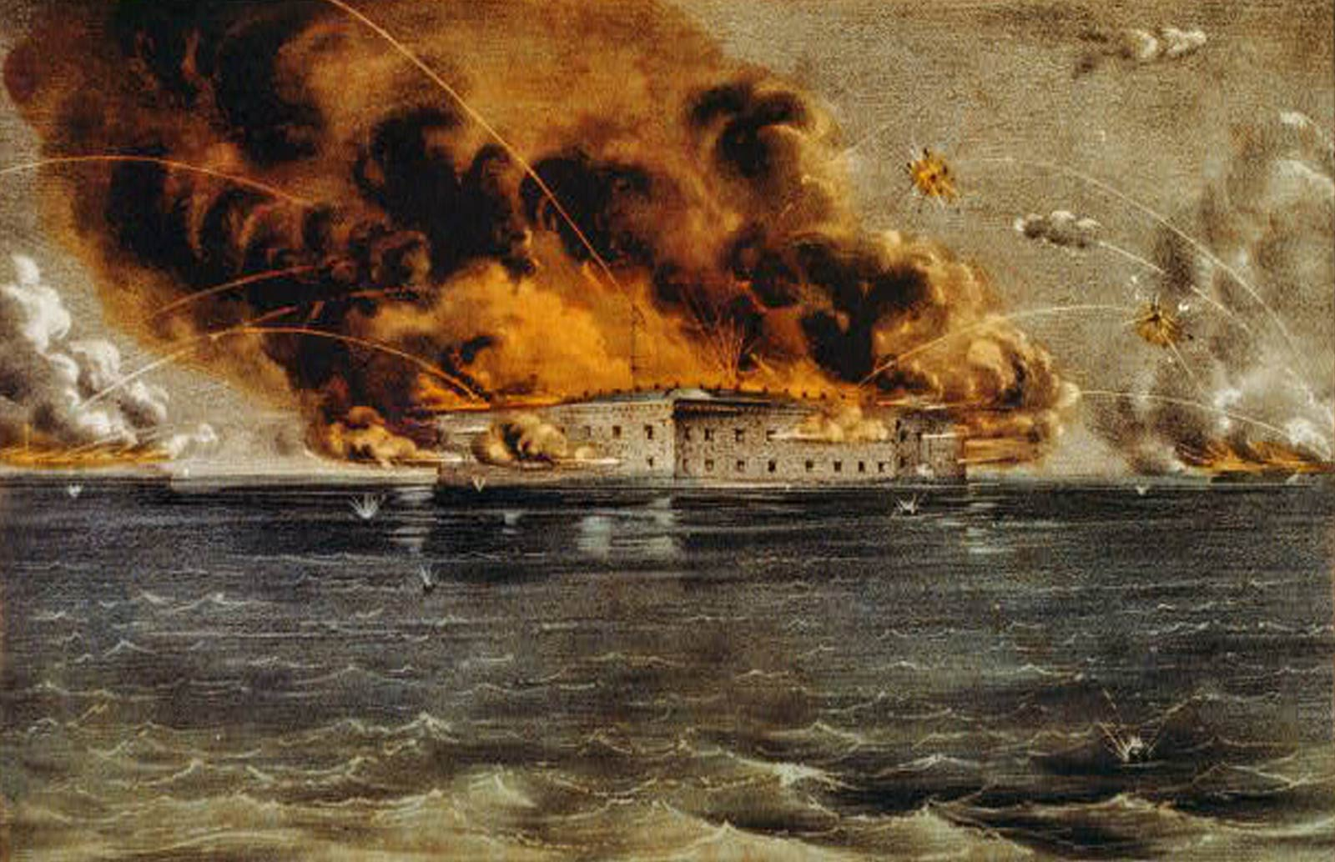
Lesson 1
Americans Choose Sides
Main Idea 3
Following the outbreak of war at Fort Sumter, Americans chose sides.
Seven southern states seceded as Lincoln took office.
Lincoln refused to recognize secession and tried desperately to save the nation.
Confederate officials began seizing federal-mint branches, arsenals, and military posts.
Fall of Fort Sumter
Fort Sumter was a Federal outpost in Charleston, South Carolina.
Confederate forces asked for its surrender.
Lincoln refused and sent ships with supplies.
Confederate cannons began firing on April 12, 1861.
Fort Sumter fell 34 hours later.
The Civil War began.
continued…

Slide 11
Reaction to Lincoln’s Call
Lincoln declared the South was in rebellion and asked state governors for 75,000 militiamen; Pennsylvania, New Jersey, and states north of them rallied.
Slave states of the Upper South—North Carolina, Tennessee, Virginia, and Arkansas—seceded.
Border states—Delaware, Kentucky, Maryland, and Missouri—were slave states that did not join the Confederacy, but people were divided on the war.
Western Virginia supported the Union and set up its own state government as West Virginia in 1863.
continued…

Slide 12
Essential Question: Exit Ticket-
How did we get to the point of secession?
What happened at Fort Sumter to start the war?

