Slide 1
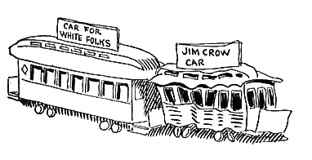
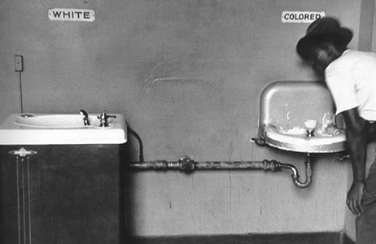
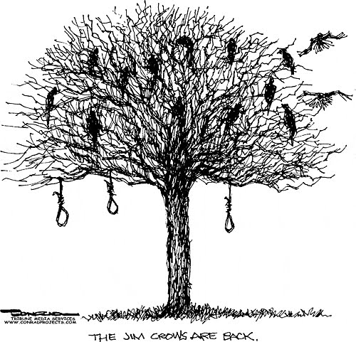
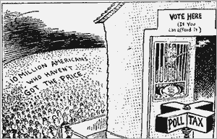
Above are examples of Black Codes/Jim Crow Laws and the effects on society. Explain how these laws kept African-Americans from gaining the rights that they were Constitutionally “guaranteed?”

Slide 2
Reconstruction & its Aftermath
8-6 The South During Reconstruction

Slide 3
Reconstruction in the South
LESSON 3
Big Idea
As Reconstruction ended, African Americans faced new hurdles and the South attempted to
rebuild.
Main Ideas
Reconstruction governments helped reform the South.
The Ku Klux Klan was organized as African Americans moved into positions of power.
As Reconstruction ended, the rights of African Americans were restricted.
Southern business leaders relied on industry to rebuild the South.
Northern focus shifted away from Reconstruction effort.

Slide 4
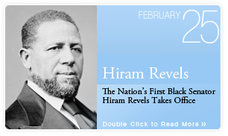
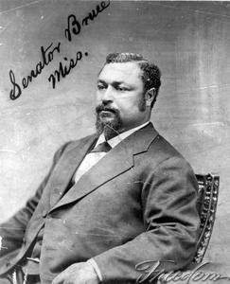
Lesson 3
Reconstruction Governments
Main Idea 1
Reconstruction governments helped reform the South.
Republicans controlled most southern governments but were unpopular with white southerners.
Northern-born Republicans who moved south after the war were called carpetbaggers.
White southern Republicans were called scalawags.
African Americans: largest group of southern Republican voters
Hiram Revels was first African American in U.S. Senate.
Blanche K. Bruce- Former runaway; became teacher in Missouri, 1869 became Superintendent in Mississippi, elected to Senate in 1874
In total 16 African Americans elected to House of Representatives and 2 elected to Senate between 1869-1880
Reconstruction state governments provided money for many new programs.
Helped establish public schools; built hospitals; passed laws against discrimination; constructed railroads and bridges

Slide 5
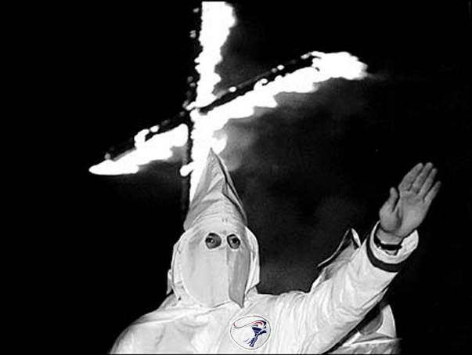
Lesson 3
Ku Klux Klan
Main Idea 2
The Ku Klux Klan was organized as African Americans moved into positions of power.
Created by group of white southerners in Tennessee in 1866
Secret society opposed to civil rights, particularly suffrage, for African Americans
Used violence and terror against African Americans
Local governments did little to stop the violence, so Congress passed the Enforcement Acts to make it a federal crime to interfere with elections or to deny citizens equal protection under the law.

Slide 6
Lesson 3
Reconstruction Ends
Main Idea 3
As Reconstruction ended, the rights of African Americans were restricted.
Republicans were losing power in southern states and in the North, and they were being blamed for the severe economic downturn called the Panic of 1873.
The close election of 1876 appeared to have been won by Democrat Samuel Tilden but was challenged by supporters of Republican Rutherford B. Hayes.
The Compromise of 1877 gave the election to Hayes, while agreeing to Democrats’ request to remove federal troops from the South.
Democrats then regained control of governments in the South, and were called Redeemers by southerners.

Slide 7
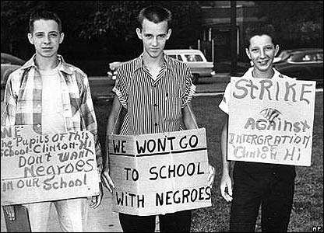
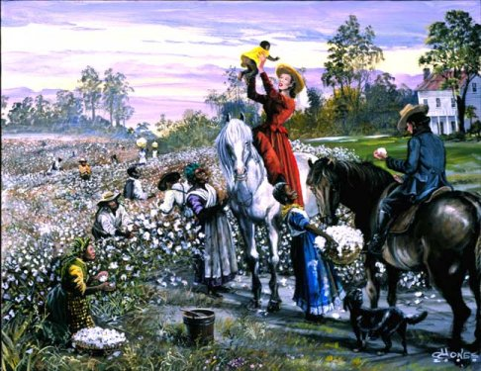
Lesson 3
African Americans’ Rights Restricted
Redeemer Governments
Set up poll tax to deny African Americans the vote
Introduced legal segregation, the forced separation of whites and African Americans in public places, through Jim Crow laws
Supreme Court
Ruled that Civil Rights Act of 1875 was unconstitutional
Plessy v. Ferguson ruled that segregation was allowed if “separate-but-equal” facilities were provided.
Sharecropping
Few African Americans could afford to buy or rent farms.
Became part of sharecropping system, providing labor to land-owners and sharing their crops with them
Sharecroppers faced debt.

Slide 8
Lesson 3
Rebuilding Southern Industry
Main Idea 4
Southern business leaders relied on industry to rebuild the South.
The southern economy suffered cycles of good and bad years, as cotton prices went up and down.
Business leaders hoped industry would strengthen the southern economy and create a New South.
The most successful industrial development was textile mills.
Work appealed to rural families.
African Americans not allowed to work in mills.
Long hours, dangerous working conditions, low wages

Slide 9
Lesson 3
Reconstruction in the North
Main Idea 5
Northern focus shifted away from Reconstruction effort.
Women and Northern African Americans
Women’s suffragists used the same arguments that Radical Republicans used when passing federal laws that required southern states to allow African American men to vote.
Utah and Wyoming granted women the vote in 1869.
African Americans in the North faced racism and segregation.
continued…

Slide 10
Lesson 3
A Changing Economy
Economies of the North and the West grew rapidly during the war and Reconstruction.
2 million immigrants who arrived between 1865 and 1873 provided labor.
Labor unions began to demand policies that protected workers.
Republican Party’s focus eventually shifted from Reconstruction toward reducing government corruption.

Slide 11
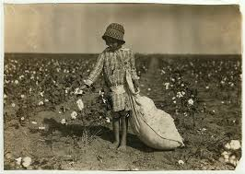
Exit Ticket
How were African Americans “kept down” in the Post-Civil War South?
Give examples…

