Slide 1
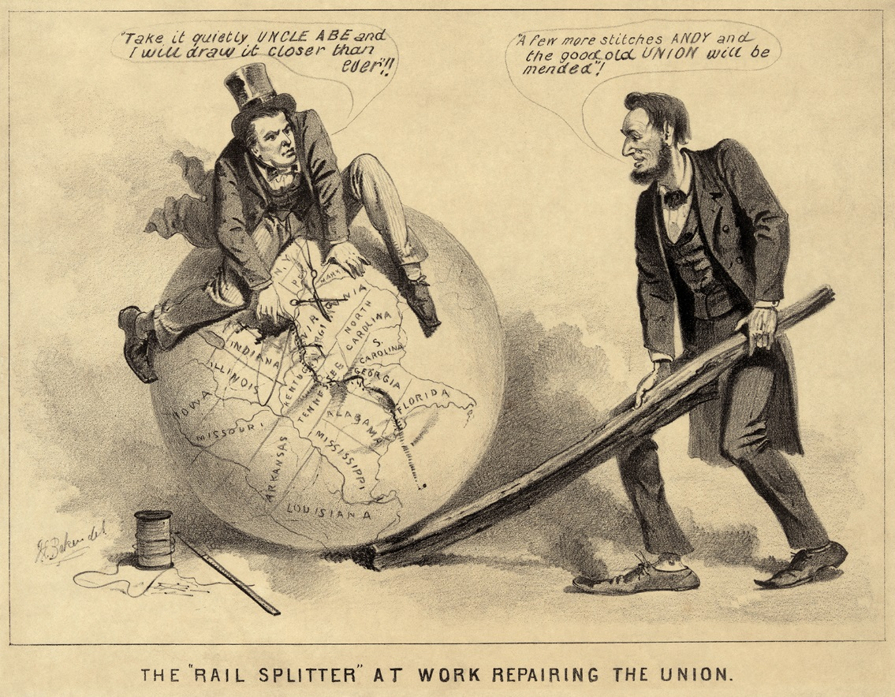
Warm Up
How did Lincoln’s death change the course of reconstruction?

Slide 2
Reconstruction & Its Aftermath
8-2 Congress Takes Charge

Slide 3
The Fight over Reconstruction
LESSON 2
Big Idea
The return to power of the pre-war southern leadership led Republicans in Congress to take
control of Reconstruction.
Main Ideas
Black Codes led to opposition to President Johnson’s plan for Reconstruction.
The Fourteenth Amendment ensured citizenship for African Americans.
Radical Republicans in Congress took charge of Reconstruction.
The Fifteenth Amendment gave African Americans the right to vote.

Slide 4
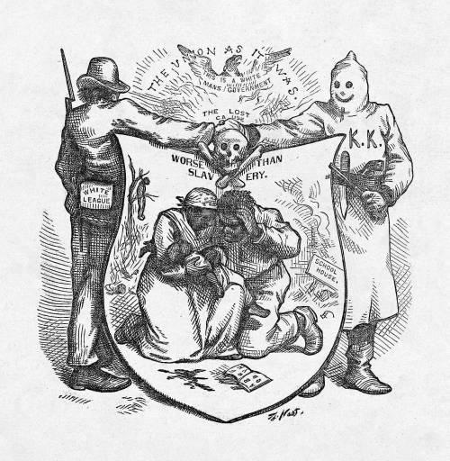
Lesson 2
Opposition to President Johnson
Main Idea 1
Black Codes led to opposition to President Johnson’s plan for Reconstruction.
Black Codes
New state legislatures approved by President Johnson began passing laws to deny civil rights to African Americans.
Every southern state passed Black Codes, laws that strictly limited the freedom of African Americans.
Could not own guns or meet after dark
Jailed without jobs
Only jobs allowed was farmer or servant
No voting
African Americans organized to oppose the codes.
continued…

Slide 5
Lesson 2
Radical Republicans
Black Codes angered many Republicans, who felt the South was returning to its old ways.
Most Republicans were moderates who hoped the South would not have to be forced into following the laws.
Radical Republicans took a harsher stance, wanting the government to force change in the South.
Thaddeus Stevens of Pennsylvania and Charles Sumner of Massachusetts were leaders.
Radical Republicans, like the moderate Republicans, believed the Black Codes were cruel.
Unlike the moderates, they wanted the federal government to be more involved in Reconstruction.

Slide 6
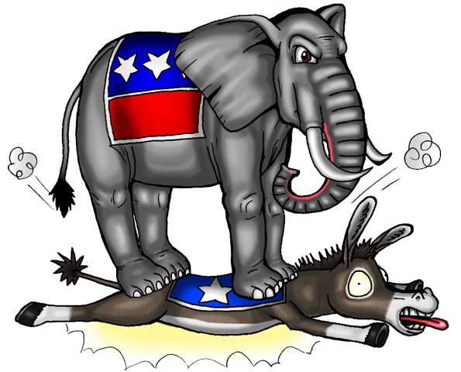
Lesson 2
Fourteenth Amendment
Main Idea 2
The Fourteenth Amendment ensured citizenship for African Americans.
Johnson versus Congress
Radicals urged Congress to pass a bill giving the Freedmen’s Bureau more power.
Johnson vetoed the bill because he said Congress could not pass laws until all southern states were back in Congress.
Republicans passed the Civil Rights Act of 1866.
Johnson again used his veto power.
Congress overrode Johnson’s veto.
Republicans feared that the Act might be overturned.
Republicans then proposed the Fourteenth Amendment in 1866.
continued…

Slide 7
Lesson 2
The Fourteenth Amendment
Defined all people born or naturalized in United States, except Native Americans, as citizens
Guaranteed citizens equal protection under the law
Said states could not “deprive any person of life, liberty, or property, without due process of law”
Banned many former Confederate officials from holding state or federal offices
Made state laws subject to federal court review
Gave Congress the power to pass any laws needed to enforce the amendment
The amendment was a key issue in the 1866 congressional elections. Riots and violence occurred. The Republicans won a commanding two-thirds majority in the House and Senate, giving them the power to override any presidential veto.

Slide 8
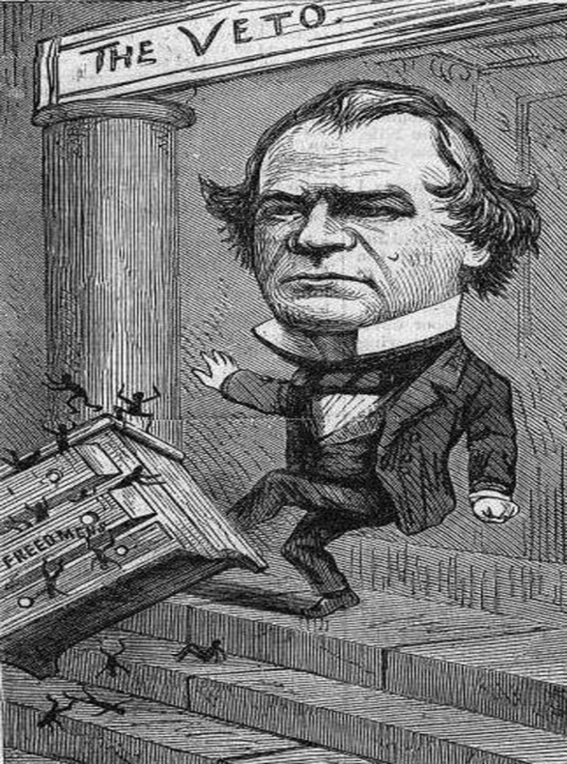
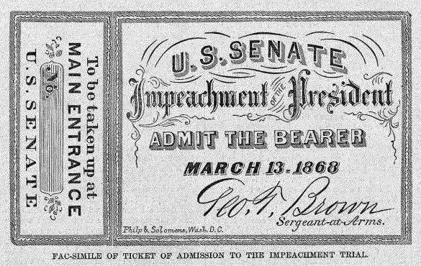
Lesson 2
Congress Takes Control of Reconstruction
Main Idea 3
Radical Republicans in Congress took charge of Reconstruction.
The elections of 1866 gave Republicans a two-thirds majority in Congress.
They passed the first of several Reconstruction Acts in 1867.
2 March 1867- put south under Martial Law, or military law
The laws divided the South into five military districts with a military commander in control of each.
Divided 10 Rebel states in 5 military districts and set in the army to take over and declared that they couldn’t become states again until elect new reps and write new constitutions
AA men over 21 would be allowed to vote
Former Confederate leaders & politicians could not vote or run for office
Each state would have to ratify 14th Amendment
The military would remain in control of the South until southern states rejoined the Union.
continued…

Slide 9
Lesson 2
President on Trial
Johnson opposed Republican Reconstruction.
Congress passed laws limiting his power.
Johnson broke the law when he fired Secretary of War Edwin Stanton.
The House of Representatives voted to impeach the president. Impeachment is the process used by the legislative body to bring charges of wrongdoing against a public official.
The Senate did not convict Johnson, but his power was greatly reduced.
Johnson decided not to run for reelection in 1868.
continued…

Slide 10
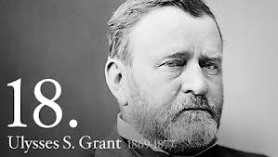
Lesson 2
Election of 1868
The war hero General Ulysses S. Grant was elected president.
He appealed to northern voters. His slogan was “Let Us Have Peace.”
Hundreds of thousands of African Americans also voted for Grant since he was from the “party of Lincoln.”
African American votes helped Grant win a narrow victory.

Slide 11
Lesson 2
Fifteenth Amendment
Main Idea 4
The Fifteenth Amendment gave African Americans the right to vote.
Radical Republicans in Control
Wanted to protect their Reconstruction plan as more southern states rejoined the Union
Proposed the Fifteenth Amendment in 1869
Fifteenth Amendment
Went into effect in 1870
Guaranteed African American men the right to vote

Slide 12
Exit Ticket: Digital Activity
Discovery Education Reconstruction Reading
Open the 8-2 CCR Discovery Ed assignment on Google Classroom and complete the assignment using the link on the left.
*You will first need to go to MY NC ED CLOUD and login and click on Discovery Ed to get the link to open!

