Slide 1
Warm Up: Spiral Review
Define sectionalism.

Slide 2
Road to Civil War: 1820-1861
7-1 “Slavery and the West”

Slide 3
LESSON 1
The Debate over Slavery
Big Idea
Antislavery literature and the annexation of new lands intensified the debate over slavery.
Main Ideas
The addition of new land in the West renewed disputes over the expansion of slavery.
The Compromise of 1850 tried to solve the disputes over slavery.
The Fugitive Slave Act caused more controversy.
Abolitionists used antislavery literature to promote opposition.

Slide 4
Lesson 1
New Land Renews Slavery Disputes
Main Idea 1
The addition of new land in the West renewed disputes over the expansion of slavery.
Additional land gained after Mexican-American War caused bitter slavery dispute.
Missouri Compromise of 1820 prohibited slavery north of latitude 36°30’.
President Polk wanted to extend the line to the West Coast, dividing Mexican Cession into free and slavery parts.
Some leaders wanted popular sovereignty, the idea that political power belongs to the people, to decide on banning or allowing slavery.
continued…

Slide 5
Adding States & Slavery Debate
The Missouri Compromise
Senate proposes plan for balance
Simultaneously admit as states
Missouri (slave)
Maine (non-slave)
Becomes known as the Missouri Compromise
Also wanted to end slavery debate in territories
All states above 36’30”° N would be free states
All states below 36’30”° N would be allowed slavery
Speaker of the House Henry Clay pushes proposals through quickly by 1820
Ends the slavery debate for 25 yrs. But comes back by 1840!
Notes:
Missouri Compromise 1820 (2:19)

Slide 6
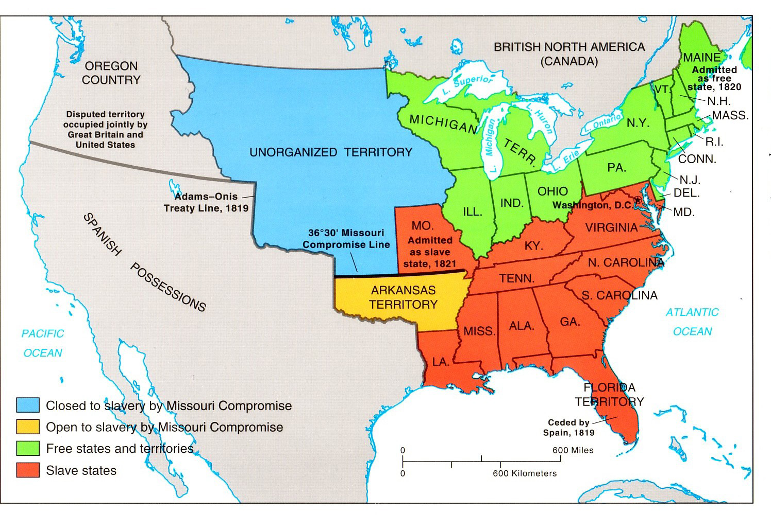
Notes:
Missouri Compromise (Drawn explanation)(3:21)

Slide 7
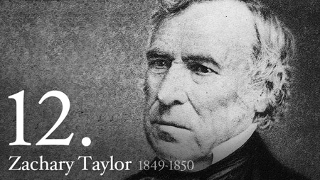
Lesson 1
Main Idea 1
Regional Differences about Slavery
Some northerners wanted to ban slavery in all parts of the Mexican Cession.
The Wilmot Proviso, prohibiting slavery there, was proposed but not enacted.
Sectionalism, favoring the interests of one section or region over the interests of the entire country, was on the rise.
Antislavery northerners formed a new party–the Free-Soil Party–to support the Wilmot Proviso.
California Question
California applied to enter the Union.
Southerners did not want California to be a free state because it would upset the balance of slave and free states.

Slide 8
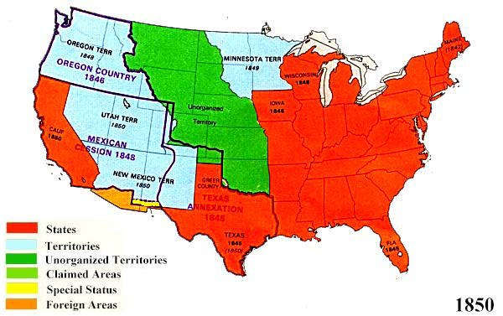

Slide 9
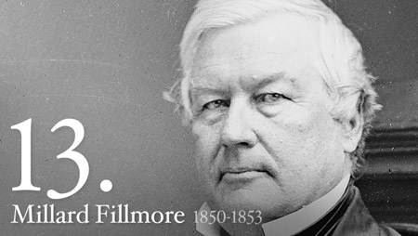

Slide 10
Lesson 1
Compromise of 1850
Main Idea 2
The Compromise of 1850 tried to solve the disputes over slavery.
Senator Henry Clay offered Compromise of 1850.
California would enter the Union as a free state.
The rest of the Mexican Cession would be federal land. The slavery question would be decided by popular sovereignty.
Texas could give up land east of the upper Rio Grande. In return, the government would pay Texas’s debt from when it was an independent republic.
Slave trade, but not slavery, would end in the nation’s capital.
A more effective fugitive slave law would be passed.
All 5-parts passed separately.
The compromise was enacted and settled most disputes between slave and free states.

Slide 11
Lesson 1
Fugitive Slave Act
Main Idea 3
The Fugitive Slave Act caused more controversy.
Details of the Fugitive Slave Act
Made it a crime to help runaway slaves and allowed officials to arrest runaway slaves in free areas
Slaveholders could take suspected fugitives to U.S. commissioners, who decided their fate. Commissioners received more money for returning them to slaveholders.
Accused fugitives could not testify on their own behalf.
Reactions to the Fugitive Slave Act
Enforcement of act immediate
Thousands of northern African Americans fled to Canada in fear.
Act upset northerners
Anthony Burns was fugitive returned to slavery with federal help in 1854.
Persuaded many to join abolitionist cause

Slide 12
Lesson 1
Antislavery Literature
Main Idea 4
Abolitionists used antislavery literature to promote opposition.
Northern abolitionists used stories of fugitive slaves to gain sympathy for their cause.
Fiction also informed people about the evils of slavery.
Uncle Tom’s Cabin by Harriet Beecher Stowe was an influential antislavery novel published in 1852.
More than 2 million copies sold within a decade.
Still widely read as source about harsh realities of slavery.

Slide 13
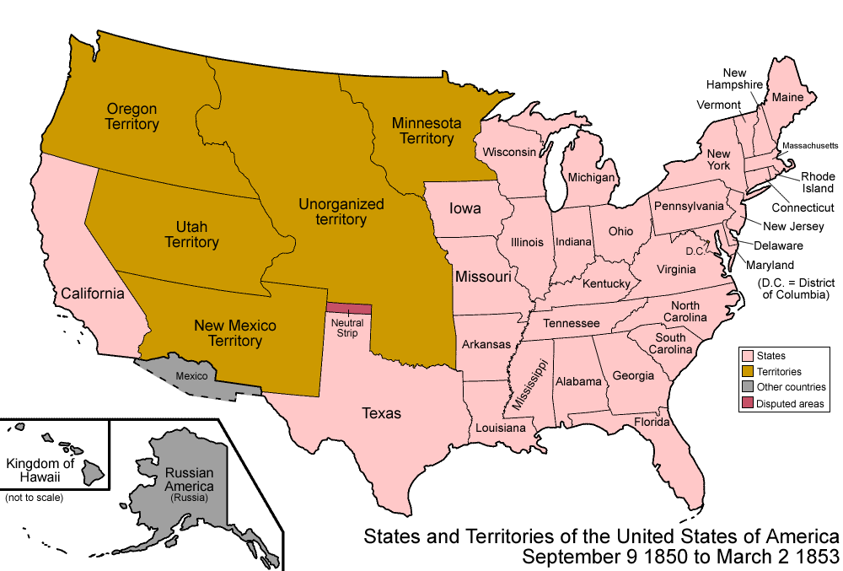
Exit Ticket: EQ Review
What are the main goals of the Missouri Compromise and Compromise of 1850 and why are they just Band-Aids?

